Slide 2
Exam – Part 2 17-05-2022

Slide 3
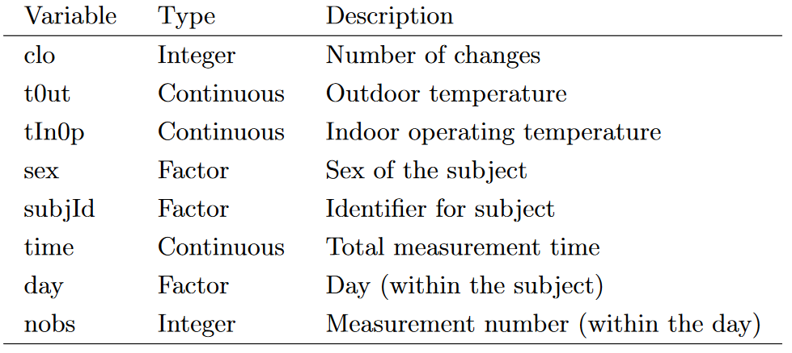
Available Data

Slide 4
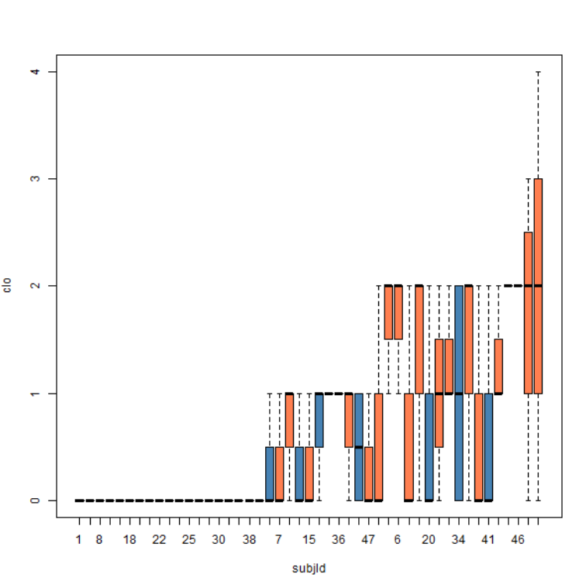
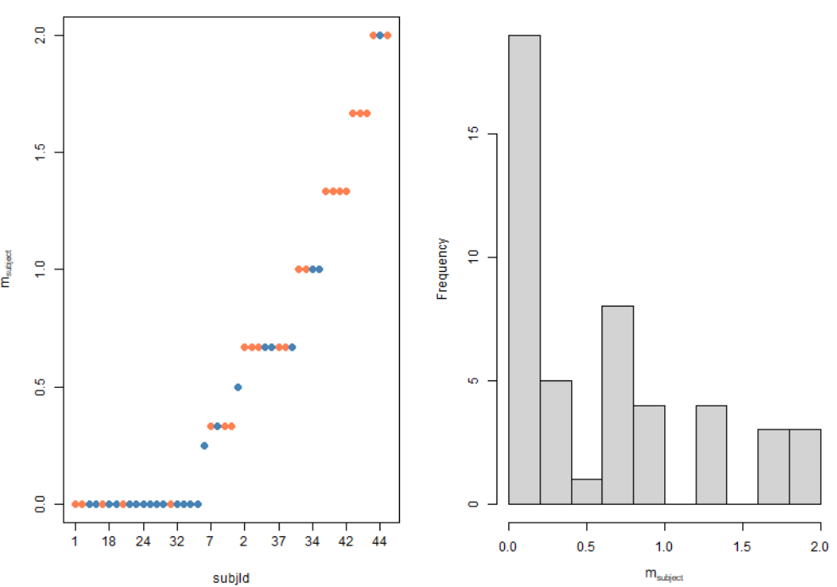
Difference in Clothing Changes

Slide 5


Model formulation and Building

Slide 6
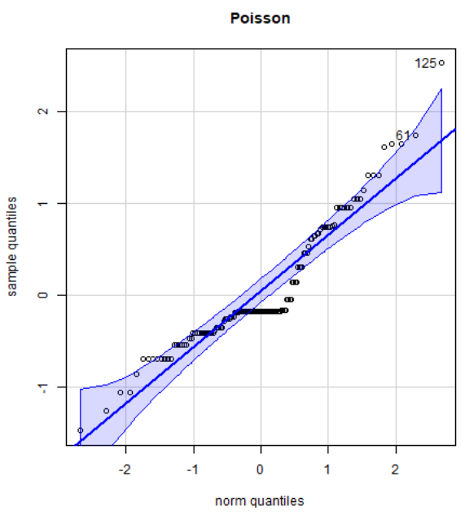
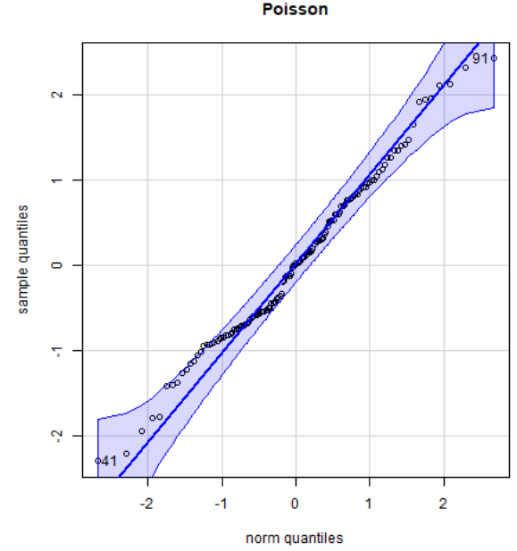
Diagnostics

Slide 7
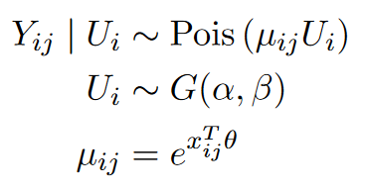


Model formulation
2021-08-26
Model specification
2021-08-26
Marginal Likelihood

Slide 8




Laplace approximation
2021-08-26
The idea

Slide 9



Analytical

Slide 10
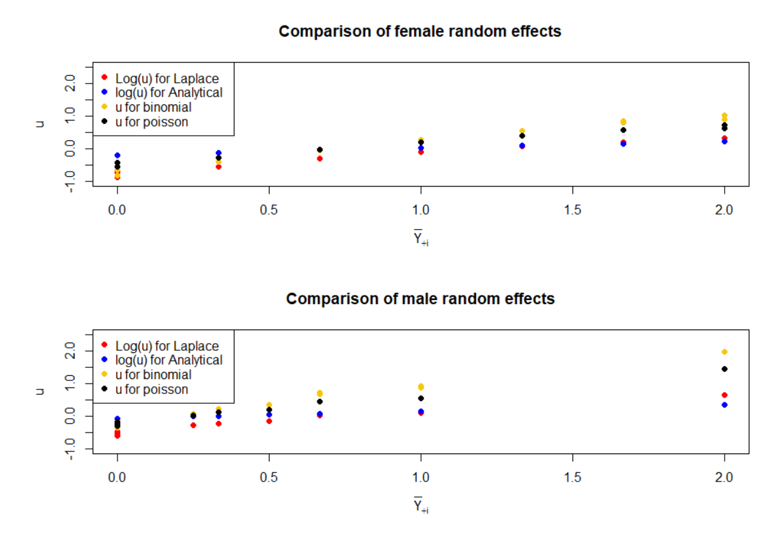

Conclusion

Slide 12
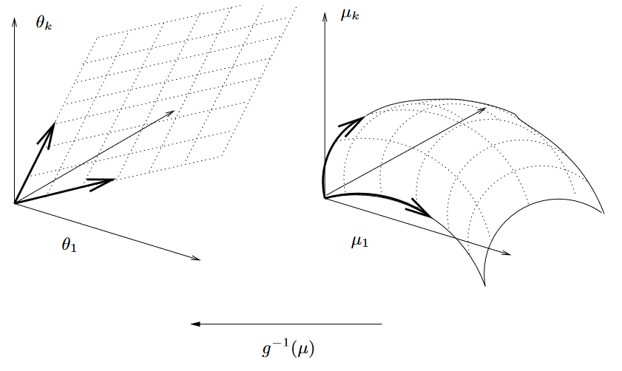
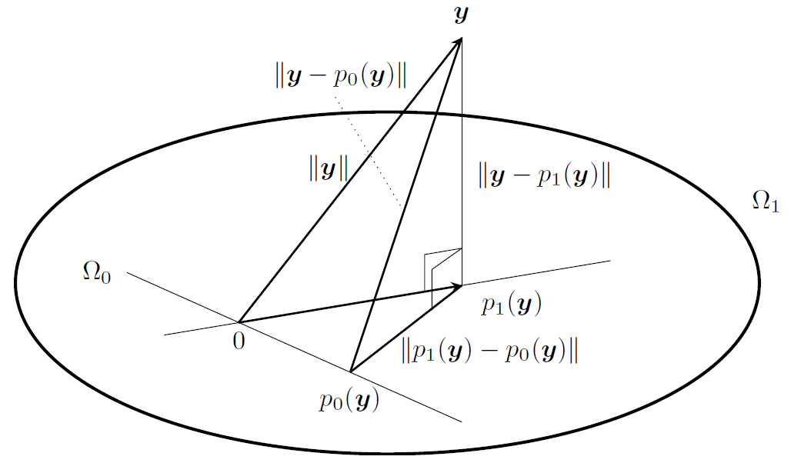
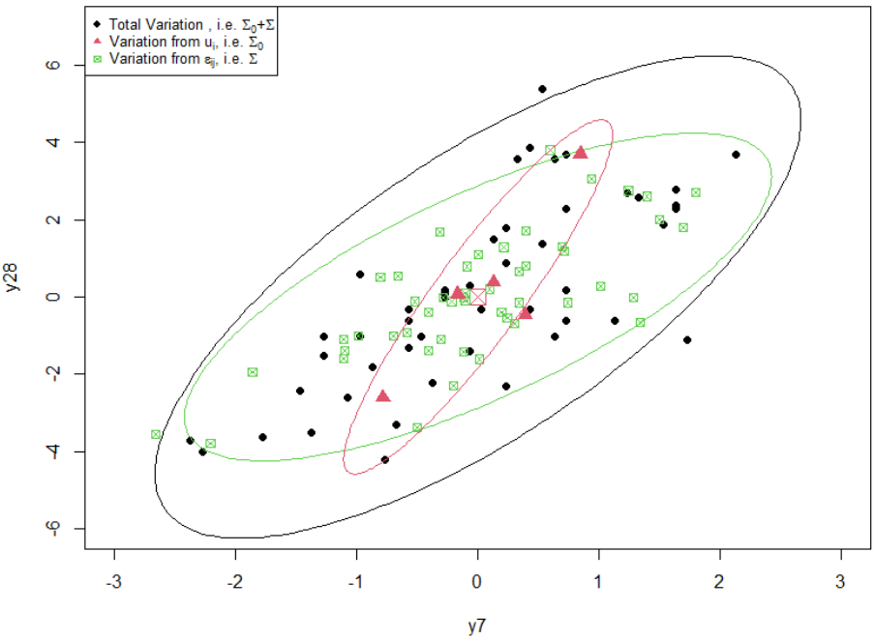
The great picture
2021-08-26
2021-08-26
Generalized Linear Models
General Linear Model
Generalized Linear Models
Mixed effect models

Slide 13
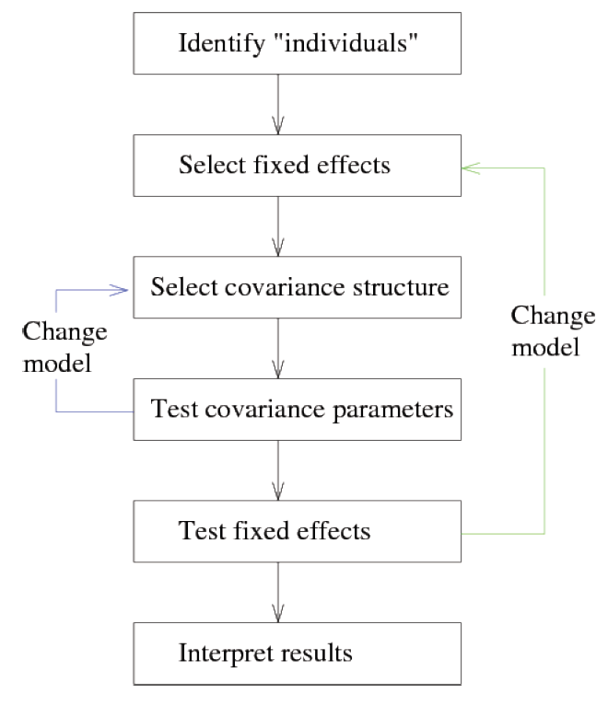
Model Building Framework

